Slide 1
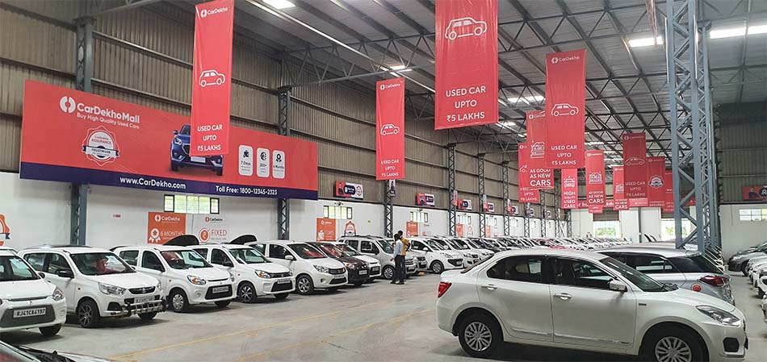
Predicting Used Car Prices using Machine Learning
A Regression Model Approach
Presented by Surendra Kumawat
Date: 02/01/2025

Slide 2
Introduction
CarDekho
Objective
India’s leading platform for buying and selling cars.
Predict car prices based on features like brand, model, mileage, engine, etc.

Slide 3
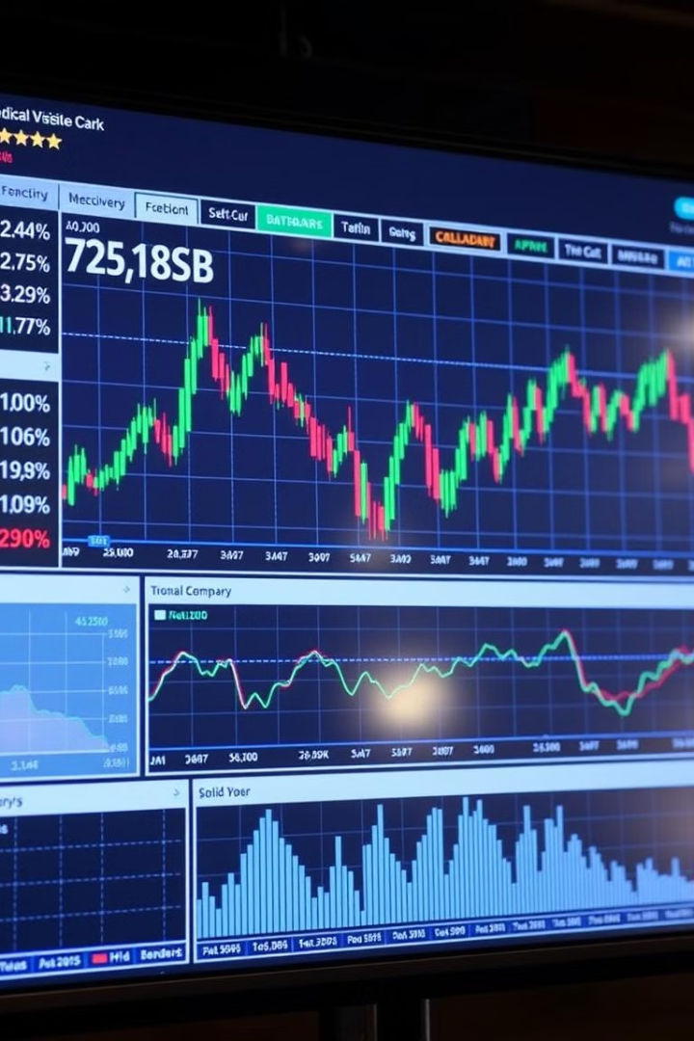
Problem Statement
The used car market is dynamic, prices fluctuate based on factors like brand, model, vehicle age, mileage, condition, and market conditions (supply and demand).
Goal: Build a machine learning model to predict the price of a used car accurately.

Slide 4
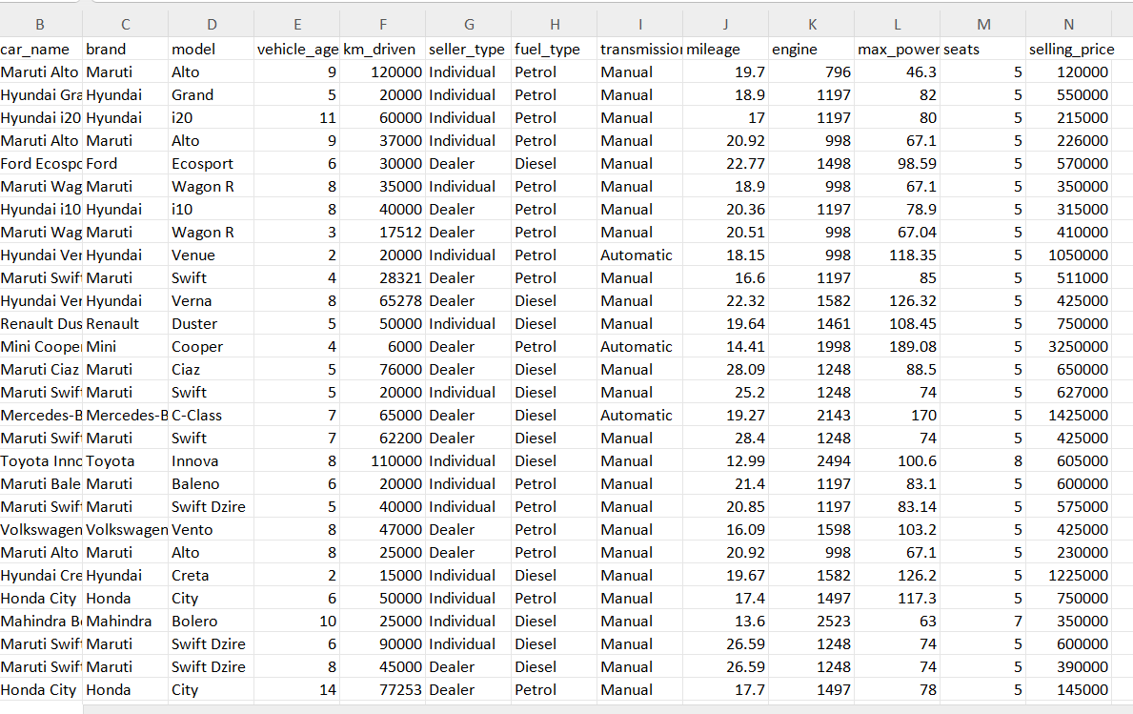
Data Overview
Dataset: CarDekho used car dataset. Features: Car name, brand, model, vehicle age, kilometers driven, fuel type, engine, max power, mileage, seats, selling price (target variable). Rows: 15,411. Columns: 14.

Slide 5
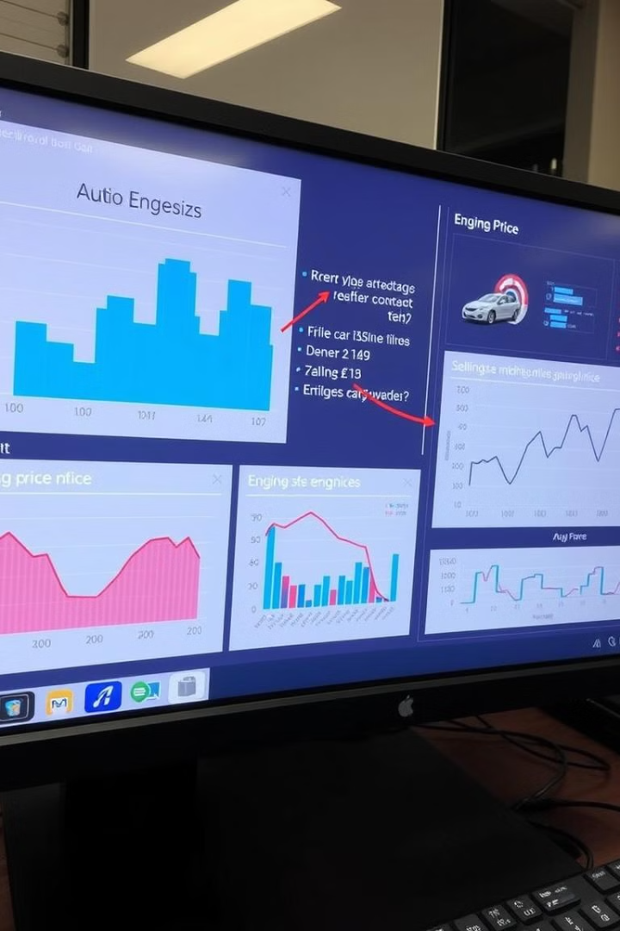
Exploratory Data Analysis (EDA)
Univariate Analysis
Bivariate Analysis
Examined the distribution of features like mileage, engine size, selling price.
Relationship between features (e.g., engine capacity vs. selling price).

Slide 6
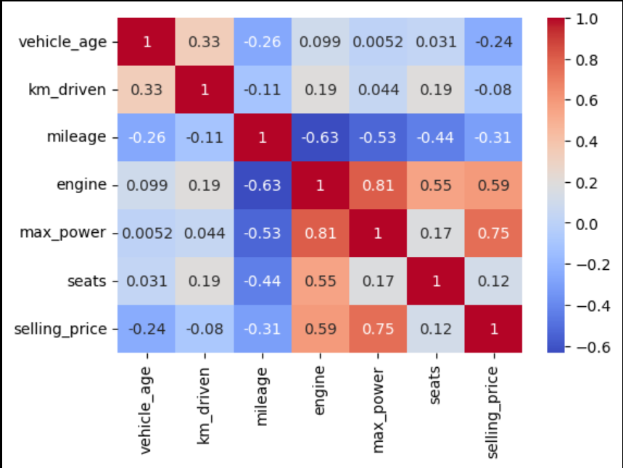
Correlation Insights
Key Insights:
Max Power has the strongest positive correlation with selling price (0.75). Mileage and Engine capacity have a negative correlation with selling price. Vehicle age and kilometers driven negatively impact car prices.

Slide 7
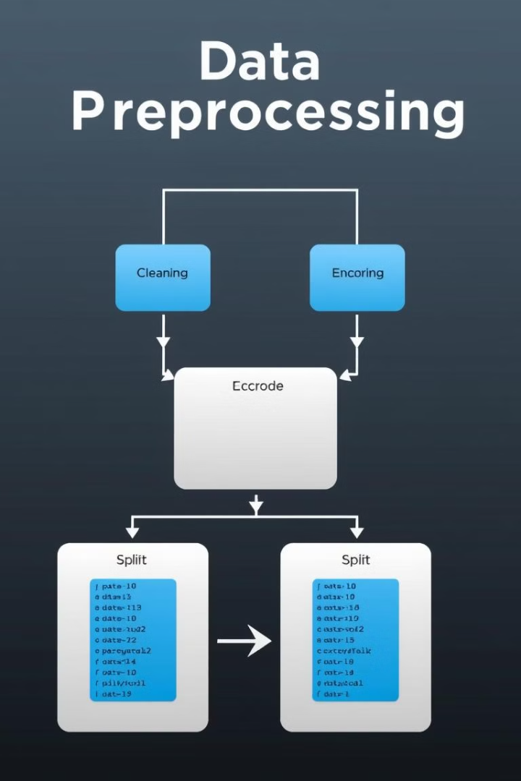
Data Preprocessing
Cleaning
Encoding
Dropped irrelevant columns like car name, brand, and model.
Used One-Hot Encoding for categorical variables like fuel type and transmission type.
Splitting Data
Divided data into training (80%) and testing (20%) sets.

Slide 8
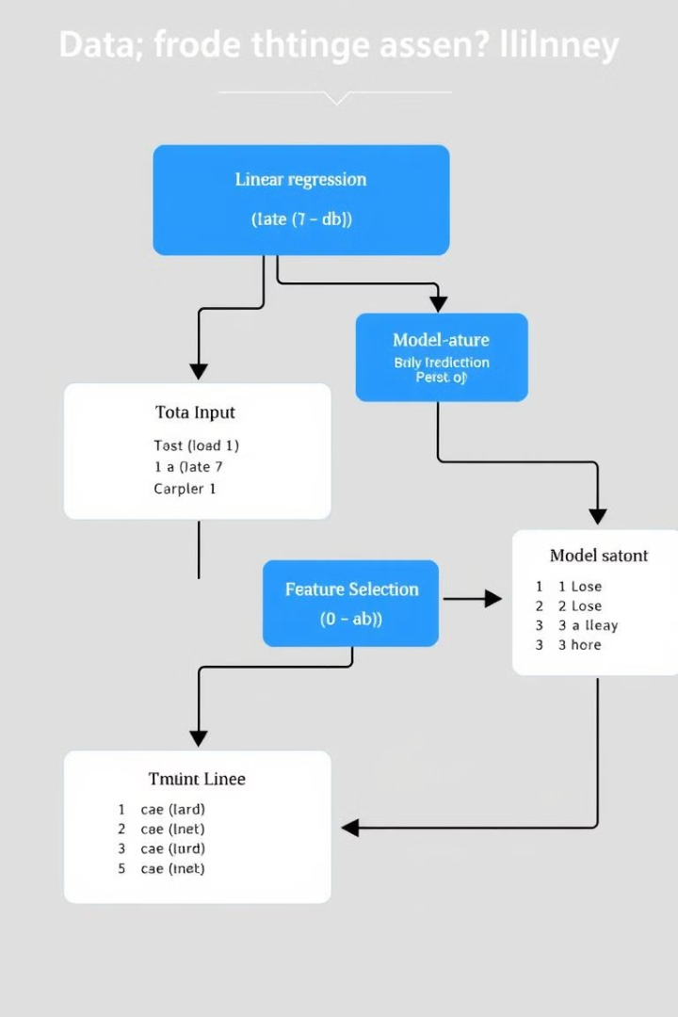


Model Building
Linear Regression Model
Training Process
Trained on the cleaned and preprocessed data. Predicted car prices using features like engine size, mileage, max power, etc.
Fit the model on the training data. Evaluated performance on the test data.

Slide 9
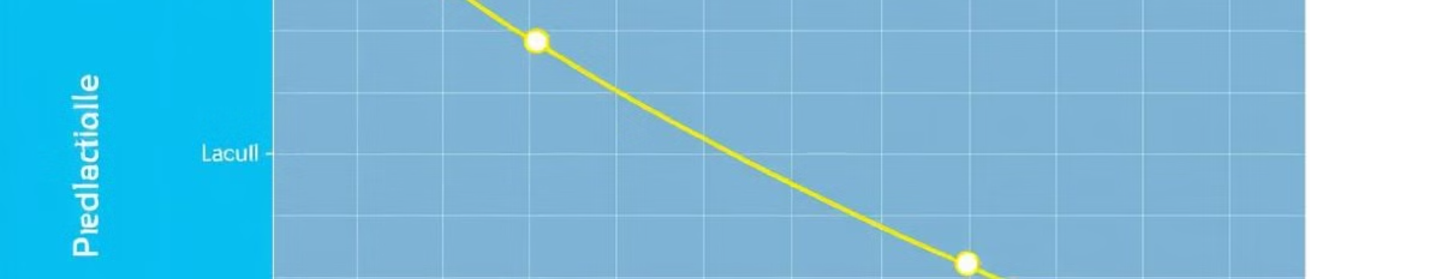
Model Evaluation
Metrics: Mean Squared Error (MSE) measures the average of squared differences between predicted and actual values.
Results: Predicted car prices closely matched actual prices. Evaluation metrics showed promising results for model accuracy.

Slide 10

Conclusion
The model provides accurate price predictions for used cars. Impact: Sellers can price their cars more effectively, Buyers can find fairly priced vehicles.
Future Work: Enhance model with additional features (e.g., geographical factors), Experiment with other machine learning models for improved accuracy.

Slide 11
Thank you for your time and attention!
Your questions and insights are always valued.

